Slide 1
5G Edge Cloud

Slide 2


Team Members
Rahul Rajkumar
Andrew Michael

Slide 3
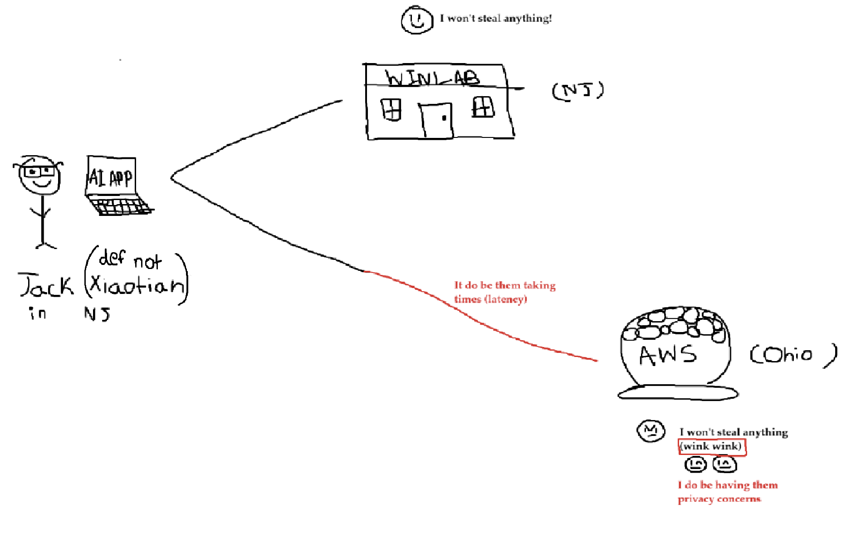
Review
What we working on: Edge
What we doing: Creating Benchmarks
Notes:
Edge computing is very similar to cloud in the sense, it’s also for offloading compute but it runs applications close to where data is generated, like on devices or local servers. This reduces the need to send data to distant cloud servers, cutting down latency and bandwidth usage. It's ideal for real-time or bandwidth-sensitive tasks. It also considers security concerns.

Slide 4
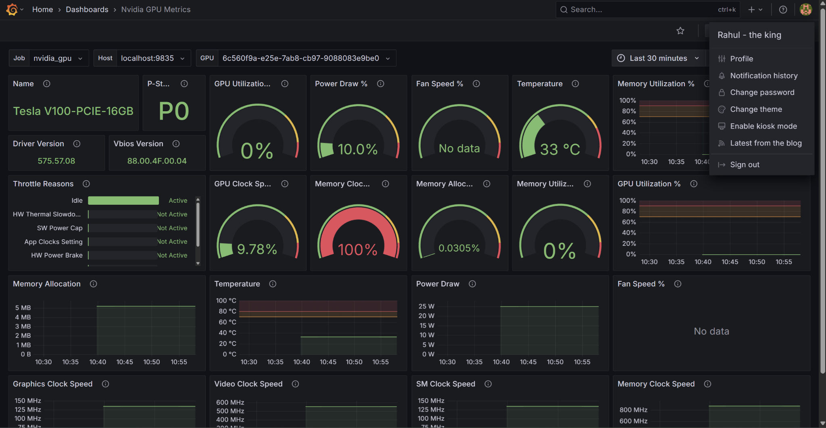
So far..
Set up data collection pipeline for dev env
Succeeded in automation of data collection
Notes:
Edge computing resources differ in capability, but users often have little visibility into what's available. Performance, latency, and power efficiency can vary significantly across edge clusters. Without clear benchmarks, it's hard to choose the right platform or optimize application deployment. Like for example, there could be clusters nearby that have compute resources like a raspberry pi or it could be all the way up to a massive server.

Slide 5
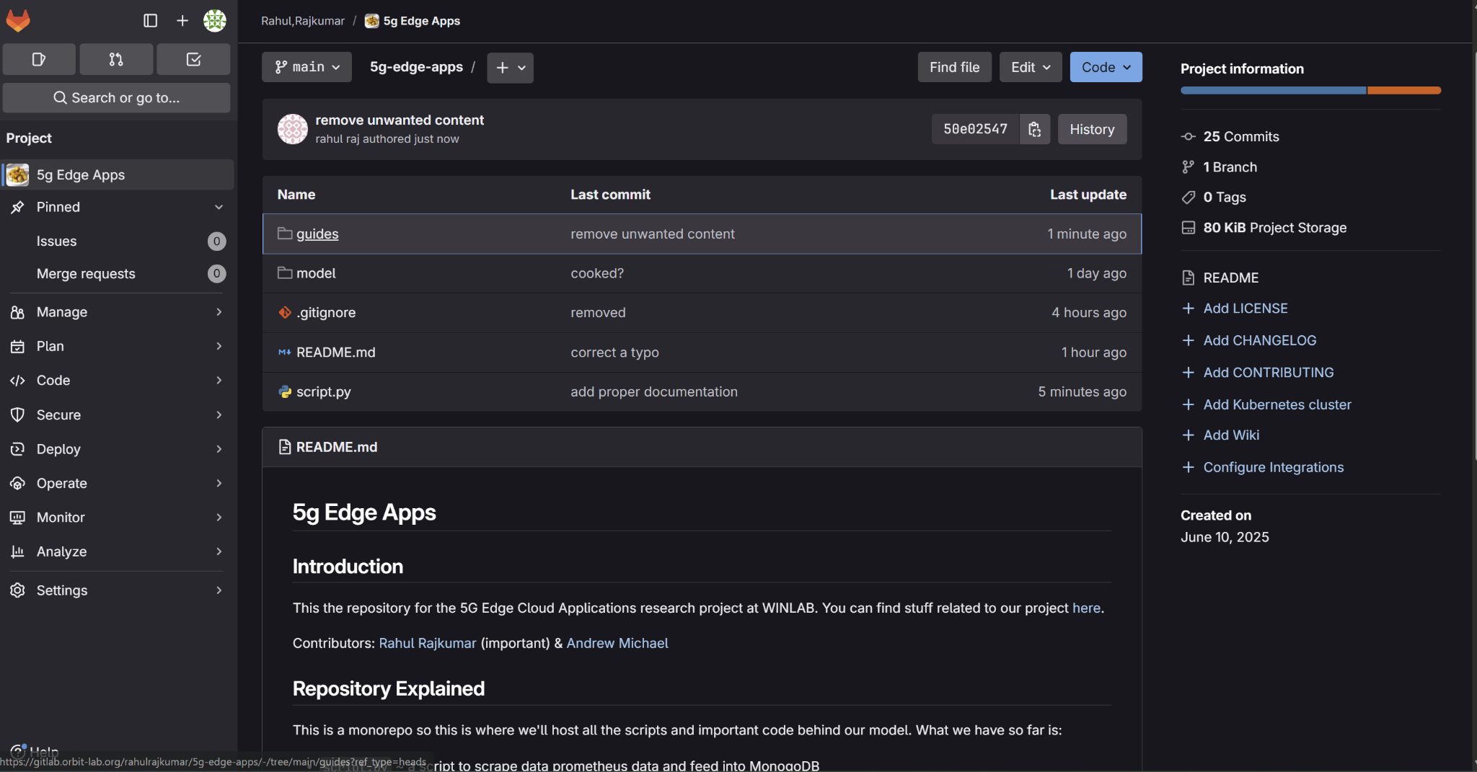
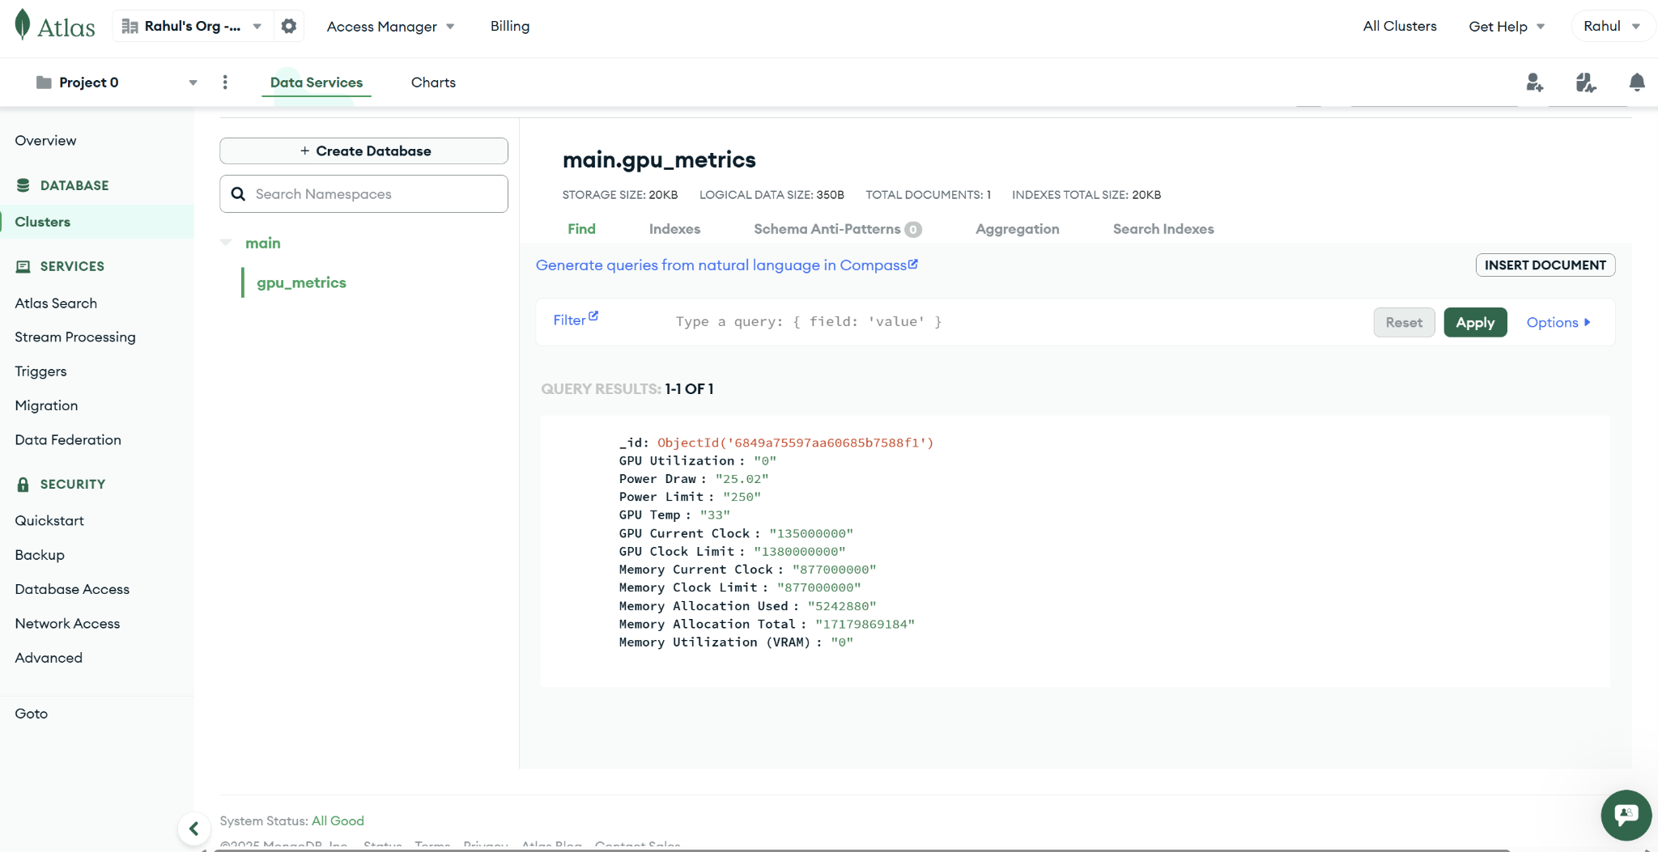
Notes:
Edge computing resources differ in capability, but users often have little visibility into what's available. Performance, latency, and power efficiency can vary significantly across edge clusters. Without clear benchmarks, it's hard to choose the right platform or optimize application deployment. Like for example, there could be clusters nearby that have compute resources like a raspberry pi or it could be all the way up to a massive server.

Slide 6

Upcoming Plans
Create randomized benchmarks
Make ML model for feature extraction & more

Slide 7
Questions?
(we should know the answer)

